Slide 1
Parent Volunteer Orientation
2022-2023 Edison Academy
Welcome Back to Campus!!
(In-person Spanish Translation Available/Meeting will be recorded)

Slide 2
Today’s Agenda
The Best Ways to Help Out at School
Volunteering - Different Levels of Support
The Process
Questions
PFO - Parent Faculty Organization

Slide 3
Parents Volunteer in Many Ways!
There are so many ways to help:
Back to School Night
Participating in Parent Teacher Conferences is one way.
Attending school site parent meetings such as:
SSC, GATE, ENGLISH LEARNER, SPECIAL EDUCATION Parent Advisory and PFO Meetings
Making Classroom Donations
As well as…
Volunteering on Campus

Slide 4
How Volunteering on Campus Helps
Provides help for individual students
Relieves teachers of some non-instructional tasks
Enhances all aspects of the educational process
Establishes a school and community partnership for quality education
Provides opportunities for meaningful service

Slide 5
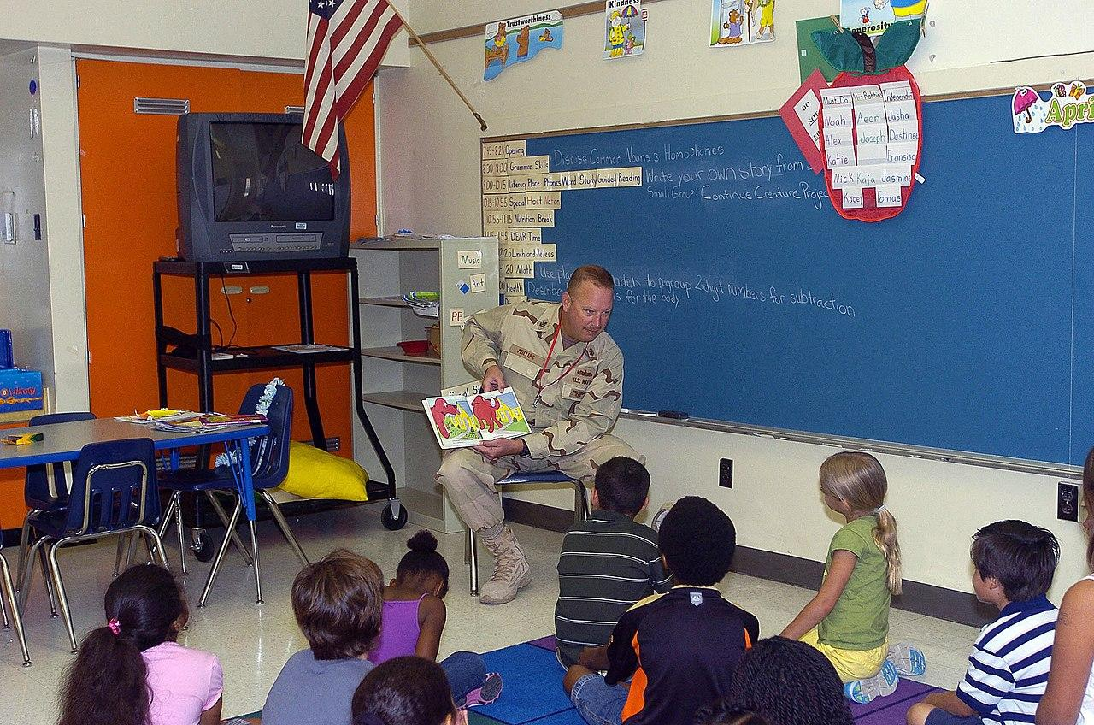
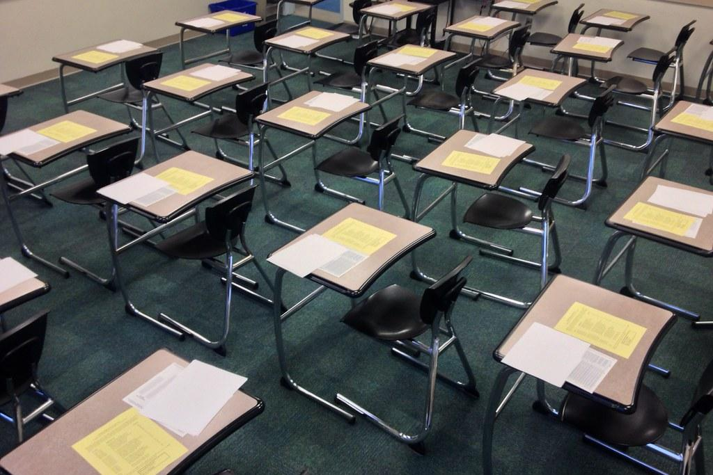
Possible Parent Activities
Small Groups
Cutting, Collating, or copying papers
Prepping Centers
Assisting students in class
And more…

Slide 6
Keys to Helping
Establish Good Rapport
Provide students help WITHOUT doing the work for them
Show genuine interest
Accept each student and encourage the best from them
Practice Patience and Kindness

Slide 7
3 Levels of Support
Minimal Classroom Help/ or Chaperone a Field Trip
Frequent Service On Campus
Overnight Event Chaperone

Slide 8
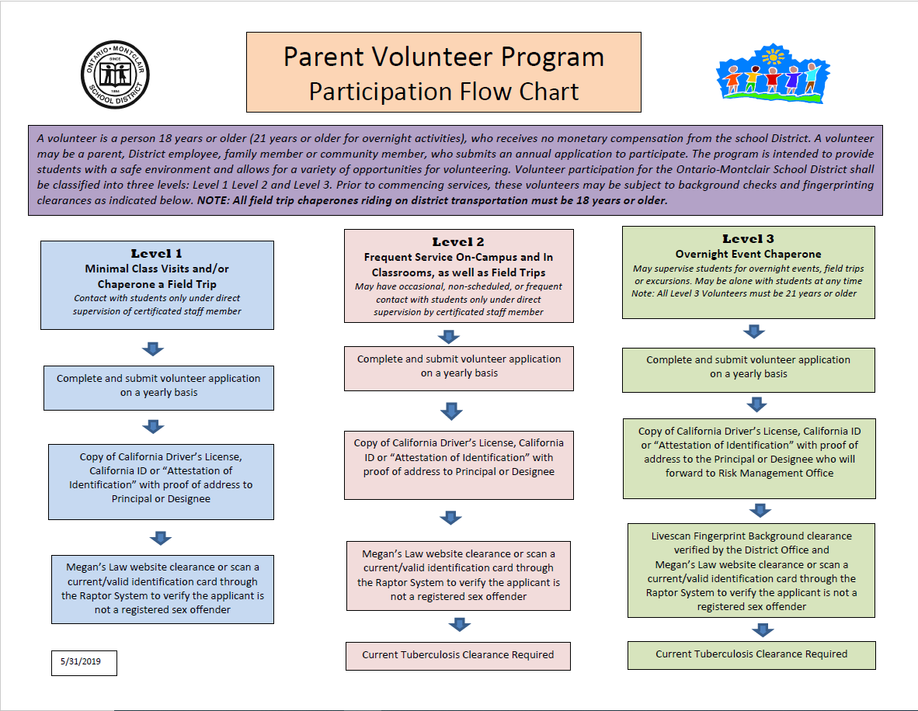

Slide 9
As a volunteer in the classroom we ask that you…
Follow directions of staff
Respect the privacy of schools and families- do not discuss school matters away from classroom
Realize only teachers evaluate students
Seek help when you have questions (ex: copy machines)
Acknowledge that teachers are responsible for discipline and you must refer any student problem to teacher: medical, instructional, procedural

Slide 10
Now, How do you get started?
Submit Volunteer Application -with Valid ID and TB test results
Upon Clearance wait to be contacted by your child’s teacher should volunteer services be needed
Proof of Address (ex: gas, phone bill)

Slide 11
The Process
Attend Volunteer Orientation
Complete Application Process
Teacher Receives List of Cleared Parents
Teacher Reaches out to parents
Teacher decides the activities needed and match volunteers to those needs
Volunteer arrives at school at designated/prearranged time
Signs into Raptor - Goes to designated area/room.

Slide 12
All Volunteers
Must
Complete Application Process
Make Prior Arrangements with Teacher
Sign-in using Raptor - bring a valid ID
Visit the area designated on your badge only
Wear appropriate attire, be respectful of all staff and students
Share concerns regarding students with the school staff only

Slide 13
We are Here to Help
Mauricio Gormaz
Principal
mauricio.gormaz@omsd.net
Dawn Swanson
Assistant Principal
Terri Castanon Administrative Assistant
dawn.swanson@omsd.net
Terri.castanon@omsd.net

Slide 15
PFO
(Parent Faculty Organization)
Jennifer Ziemer - PFO president
jziemer1030@gmail.com
Remember: Edison’s PFO needs parents to volunteer to help organize experiences that your kids will enjoy and remember…
Next Meeting is:
Thursday, October 27 time TBD

